Slide 1
Geocoding for distance based fuzzy matching (USA) – User Guide

Slide 2
Agenda
Introduction
Technical requirement
Working
Code Snippet

Slide 3




Introduction
Tool description
This tool matches accounts/HCPs with each other based on distance between them
After using the ‘Fuzzy Match’ tool, it is cumbersome to manually check the addresses on google maps or any other source
Geocoding for distance based fuzzy matching is done to obtain the coordinates of these addresses and to identify which ones are the same
The input addresses are searched for their coordinates in a database (geodb.csv)
The coordinates of the addresses not present in the above database are taken from two websites – Open street maps and US Census Bureau.
After obtaining the coordinates of the two addresses (Source and ITM), the haversine distance between the two addresses is computed
A distribution of the distance between the Source and ITM addresses is presented as a graph to help the user decide upon a suitable distance threshold
Two addresses which are within the specified distance threshold are assumed to be same

Slide 4

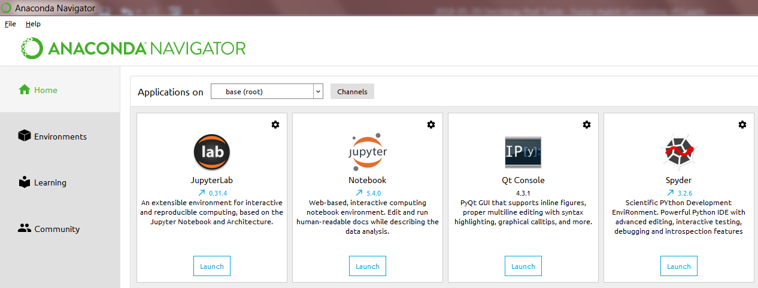
Technical Requirements
Anaconda navigator
Anaconda Navigator is a desktop graphical user interface (GUI) included in Anaconda® distribution that allows you to launch applications and easily manage conda packages, environments and channels without using command-line commands.
Jupyter notebook
The Jupyter Notebook is an open-source web application that allows you to create and share documents that contain live code, equations, visualizations and narrative text.
Open Anaconda navigator and launch Jupyter notebook.
Click the headers to get redirected to the respective download page. Access from IT will be required for installation

Slide 5
Working
Process Flow
1
Create the input dataset with the output from ‘Fuzzy MatchMaker’ tool – store it as a csv file: “input.csv” (Follow the header names and layout of the file in footer below¹)
2
Change the source in the “path_to_input” variable with the directory path of your input file by replacing “\” with “/” and run the code
3
The output file will be generated in the working directory set in the variable “path_to_output”. Change this with the desired directory path.
4
Specify the distance threshold to be used by changing the value ‘0.18 miles’ in the variable “distance_threshold”. Execute the code -‘Geocoding_for_fuzzy_matching.ipynb’
5
The process requires a stable internet connection to avoid disconnects during retrieval. Try rerunning the code for cases where info wasn’t retrieved
1. Copy the header names from the file and paste available information in the appropriate columns before saving it as “input.csv”

Slide 6
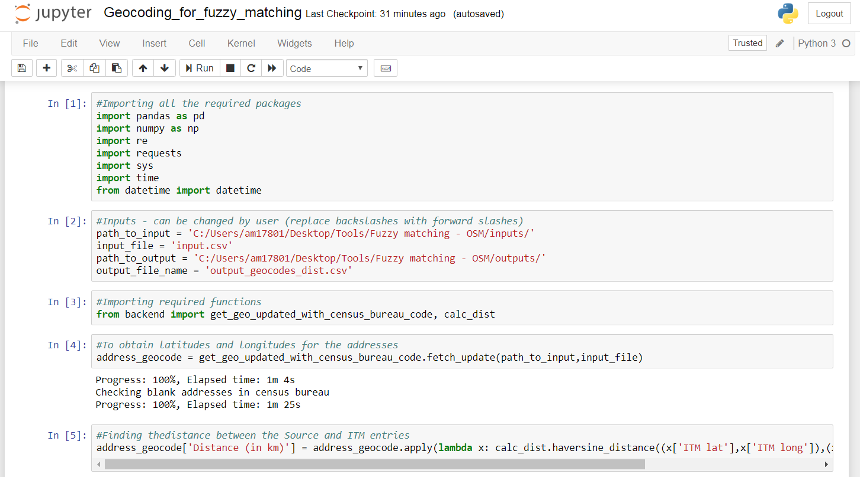
Code Snippet
Snapshot of Code with Comments for explanation

